Slide 1
Deeplearning Lab: Piecewise monocular depth estimation by plane fitting
Getting started!

Slide 2


Configure VPN
Download & install OpenVPN-Client
Download & unzip VPN-Configuration files
Start OpenVPN → klick top left Button → then „Import Profile“ → klick on „File“ → drag & drop „labvpn-0*-VI-client.ovpn“ into the window
Enter your Username „vilab**“ → mark the „Save Password“ Checkbox and enter your VPN-Password
Klick in top right corner „Add“
Click on the Slider to connet the VPN

Slide 3
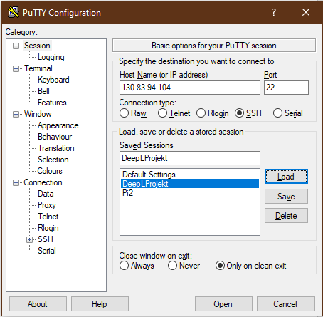
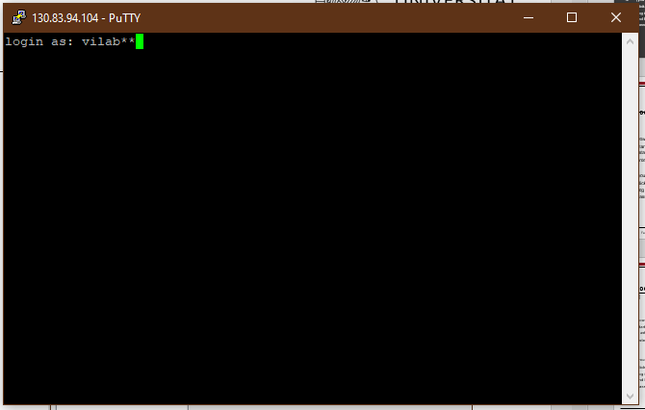
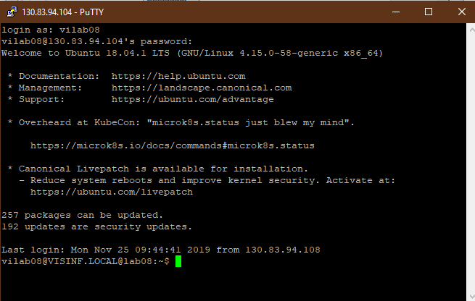
Get connectet via SSH
Download & install Putty
Start Putty (VPN connection must be established)
Enter “Host Name” here:
130.83.94.104 (the only IP I have)
(you can save it if you want)
Klick “Open”
Enter your Username “vilab**” → hit enter
Enter your Password (not the VPN-Password) → hit enter
If you are connected it should be look like →
This window is the same as a normal Linux-Terminal

Slide 4
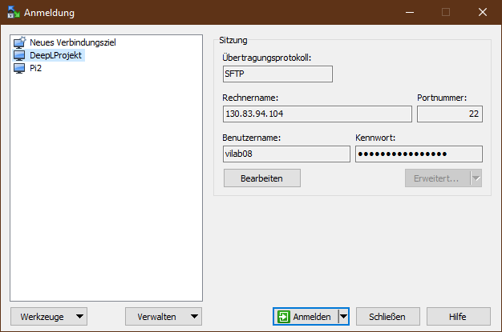
Get connected via WinSCP
With WinSCP you can better navigate in folders, copy and upload and download data
Download & install WinSCP
You can import saved Putty Sessions into WinSCP (WinSCP will ask you)
Enter the same Login Data you used in Putty
On „Bearbeiten“ you can save the username and Password
Hit „Anmelden“
Navigation is very intuitive.

Slide 5
Install Anaconda on your Account
Since we don't have an admin account, every user has to install anaconda himself
follow the instructions step by step
If you are ready, go into your environment and install the following packages:
pip install scikit-image
pip install tensorboardX==1.4
pip install ipython
conda install pytorch=0.4.1 torchvision=0.2.1 -c pytorch
conda install opencv=3.3.1

Slide 6
Test your Python istallation
0. Type into Terminal „screen –s (name)“ (opens a new screen. You are now able to close the terminal without killing the process. → for more information: Useful Commands
1. Navigate in the Terminal to the folder with „test_simple.py“
2. Here you start your pyhton environment.
3. Enter the command →
4. If it works you can follow the instructions from Monodepht2
python test_simple.py --image_path assets/test_image.jpg --model_name mono+stereo_640x192

Slide 7
Kitti-Dataset
-The raw Kitti-Dataset is located at:
/data/vilab10/Deep-Learning-Lab-master/reference code/monodepth2-master/kitti_data
-The jpg converted Kitti Dataset is located at:
/data/vilab08/Monodepth2/kitti_data
You can only copy the data into these folders, you can't write.
So if you do a run, you first have to copy the data into a directory where you can write.

Slide 8
Useful Commands (more on GitHub Monodepht2 bottom)
CUDA_VISIBLE_DEVICES=1 python train.py --model_name first_run --log_dir /data/vilab08/Monodepth2/tensorboard_log →To use the graphic card
Check GPU Usage → „nvidia-smi“
python evaluate_depth.py --load_weights_folder /data/vilab08/Monodepth2/tensorboard_log/models/weights_19/ --eval_mono

Slide 9
Start Tensorboard
for tensorboard go to install location: /visinf/home/vilab08/anaconda3/envs/my_env/lib/python3.6/site-packages/tensorboardX
then:
python main.py --logdir= /data/vilab08/Monodepth2/tensorboard_log

